Slide 1
Input Voltage Level
FSR 1

Slide 2
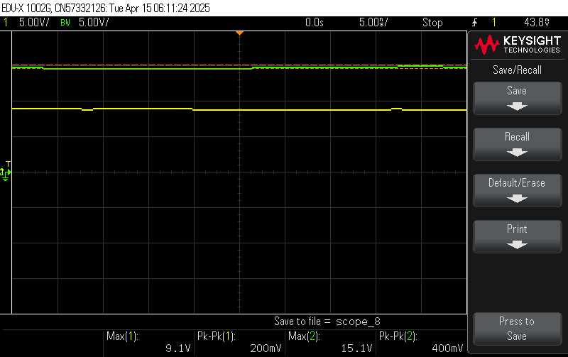
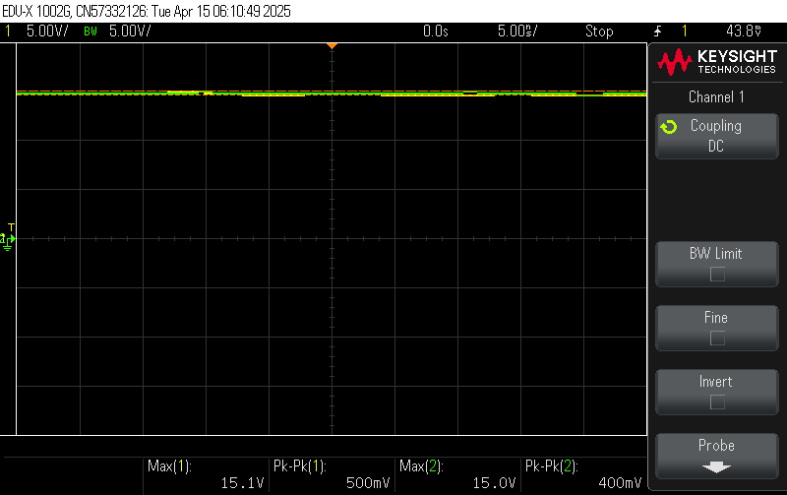
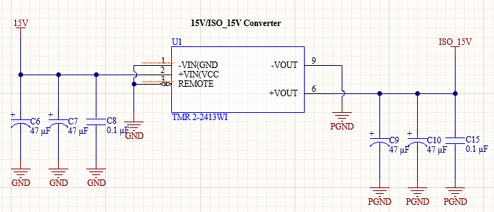
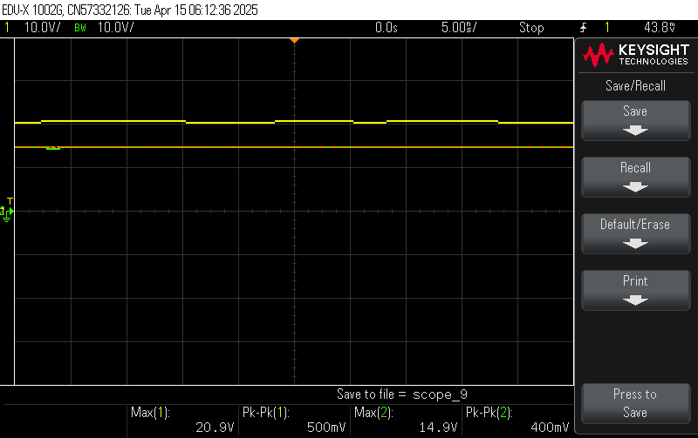
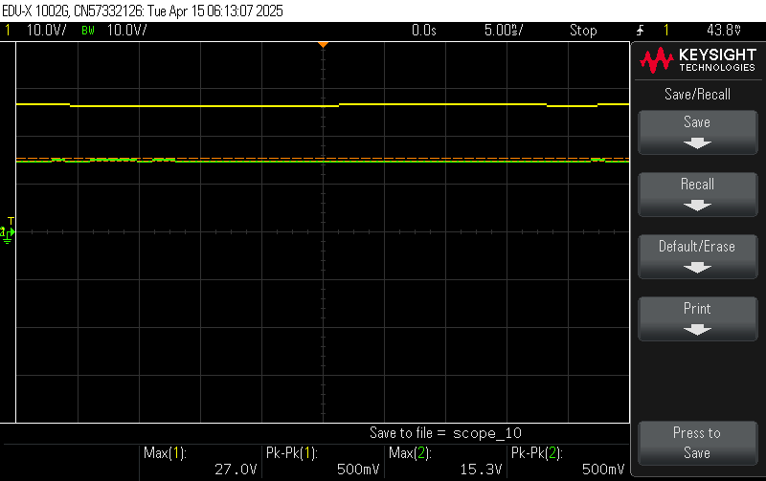
Power converters shall convert 15 VDC to isolated 15 VDC.
V_{in} (V) | V_{in,pp} (mV) | V_{out} (V) | V_{out,pp} (mV)
9.1 | 200 | 15.1 | 400
15.1 | 500 | 15.0 | 400
20.9 | 500 | 14.9 | 400
27.0 | 500 | 15.3 | 500
33.040 | 578 | 14.887 | 264
35.804 | 503 | 14.887 | 264
I_{out} (mA) | V_{out} (V)
12 | 14.959
25 | 14.951
50 | 14.937
75 | 14.924
100 | 14.912
125 | 14.898
134 | 14.893
Vin = 9 V
Vin = 15 V
Vin = 21 V
Vin = 27 V

Slide 3
Power converters shall convert 15 VDC to 3.3 VDC.
V_{in} (V) | V_{out} (V)
16.0 | 3.003
15.5 | 3.2997
15.0 | 3.2997
14.5 | 3.2995
Load (mA) | V_{out} (V)
0 | 3.2993
30 | 3.2952
50 | 3.2824
72 | 3.2812
95 | 3.2601
122 | 3.2512
153 | 3.2243

Slide 4
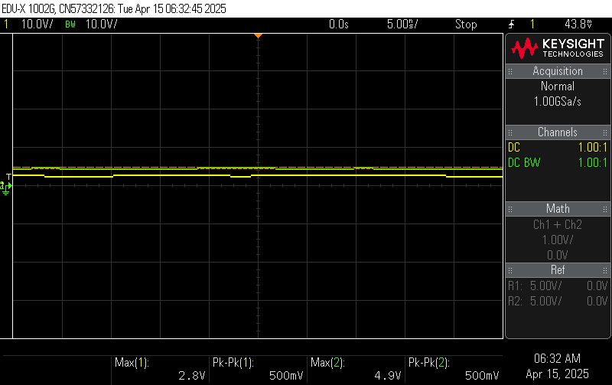
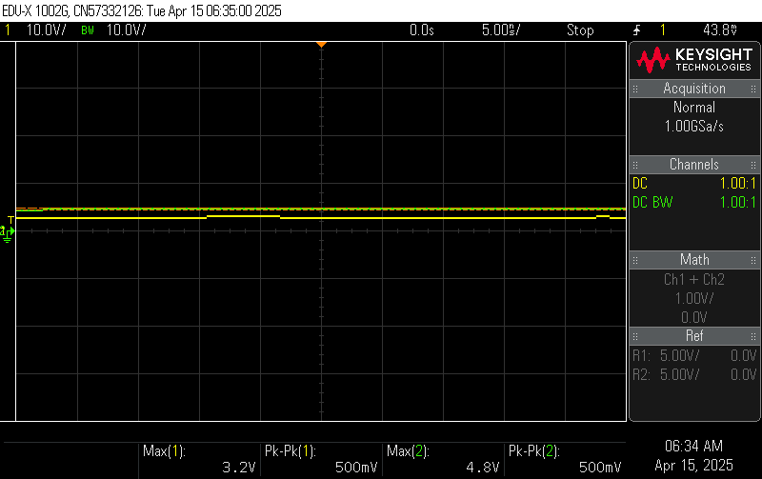
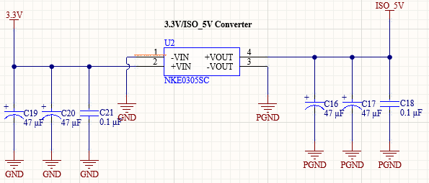
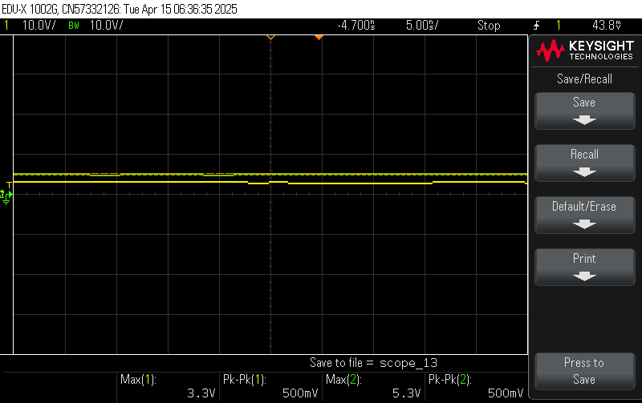

Power converters shall convert 3.3 VDC to isolated 5 VDC.
V_{in} (V) | V_{in,pp} (mV) | V_{out} (V) | V_{out,pp} (mV)
2.8 | 500 | 4.9 | 500
3.2 | 500 | 4.8 | 500
3.3 | 500 | 5.3 | 500
3.6 | 900 | 5.7 | 500
I_{out} (mA) | V_{out} (V)
12 | 5.381
50 | 5.188
100 | 4.981
150 | 4.782
200 | 4.581
Vin = 2.8 V
Vin = 3.2 V
Vin = 3.3 V
Vin = 3.6 V

Slide 5
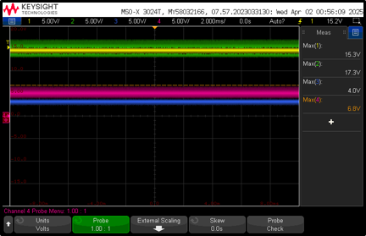
System shall convert 15 VDC to isolated 15 VDC , 3.3 VDC, and isolated 5 VDC.
Converter​ | V_{spec} [V]​ | V_{min} [V]​ | V_{nom} [V]​ | V_{max} [V]​
2-Phase to 15V​ | 15.0​ | ​ | 15.0​ | ​
15V to Iso15V​​ | 15.0​ | 14.9​ | 15.1​ | 15.3​
15V to 3.3V​​ | 3.3​ | 3.2​ | 3.3​ | 3.3​
3.3V to Iso5V​​ | 5.0​ | 4.6​ | 5.1​ | 5.6​

Slide 6
Power converters shall convert 120 VAC to 15 VDC.
Vin (VAC) | Vout (VDC)
118 | 15.0

Slide 7
On/Off Functionality
FSR 2

Slide 8
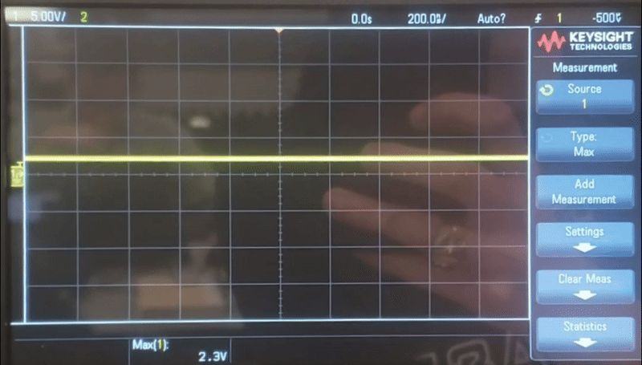
Relay shall toggle the motor with the relay signal.
Vin
5-40V | Contact Voltage | Rated up to required voltage
15V | Coil Voltage
5V | Relay Signal

Slide 9
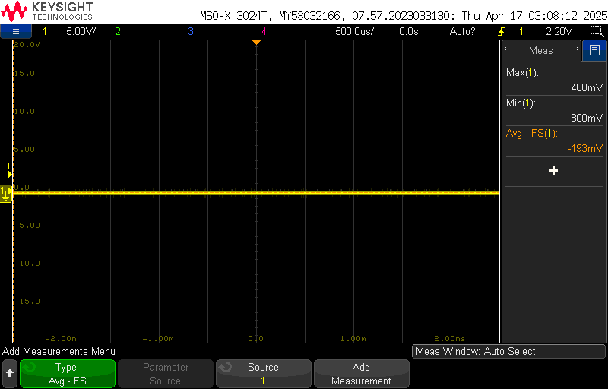
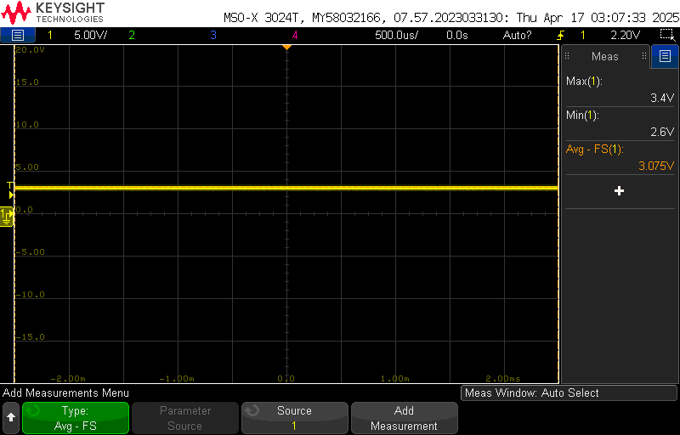
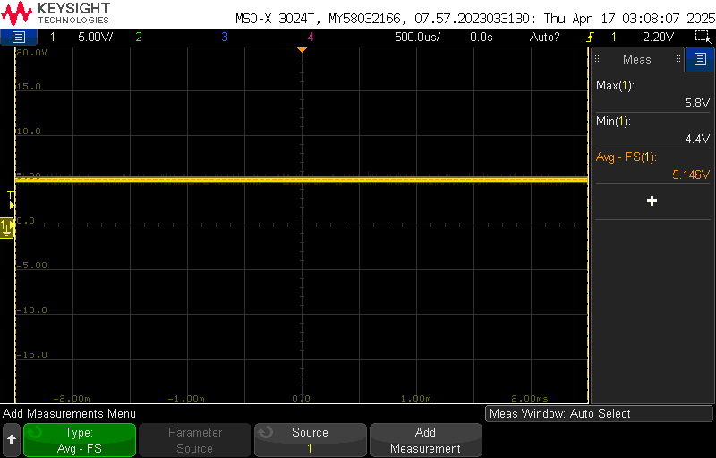
Digital to power shall convert the relay signal from 3.3 V_{DC} to 5 V_{DC}.
~0 V when button off 3.4 V before isolator 5.8V after isolator

Slide 10
MCU shall toggle the relay signal to 3.3 V_{DC} with the button signal.
Relay
On | Off
3.281V | -.045V

Slide 11
Button shall toggle the button signal to 3.3 V_{DC} with a button press.
Button
Not Pressed | Pressed
3.25V | -.048V

Slide 12
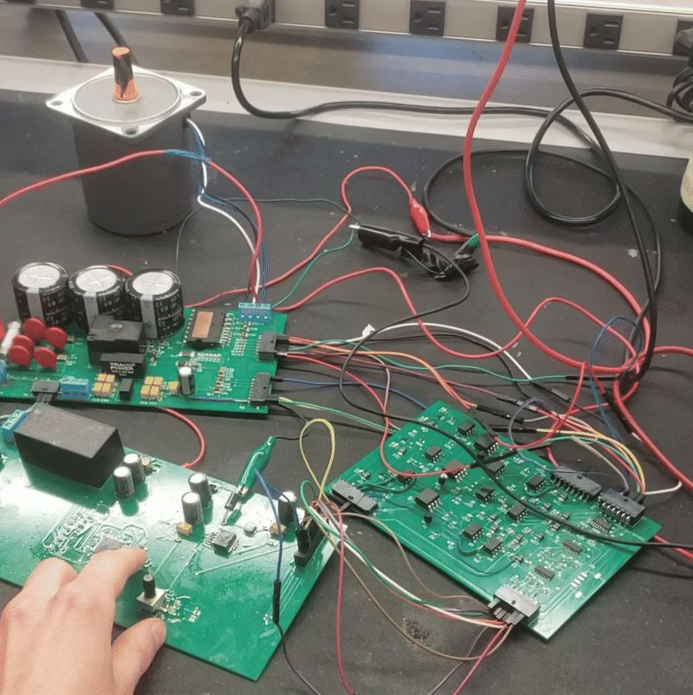
System shall toggle the motor between on and off state with a button press.
On/Off Button

Slide 13
Motor Runs at Correct Voltage
FSR 3

Slide 14
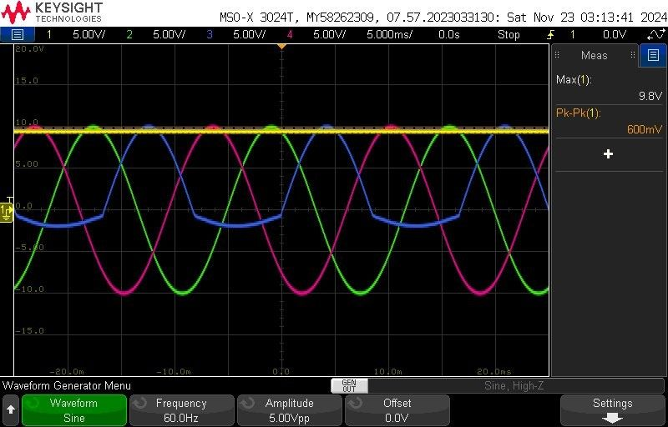
Rectifier shall convert 120 V_{AC} to 112 V_{DC}.

Slide 15
PWM Signals
FSR 4

Slide 16
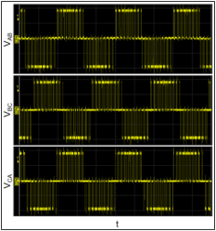
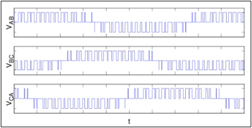
Power control shall invert three high and three low 5 V_{DC} PWM signals into three modified sine waves.
Measured Line to Line Waveforms
Expected Line to Line Waveforms

Slide 17
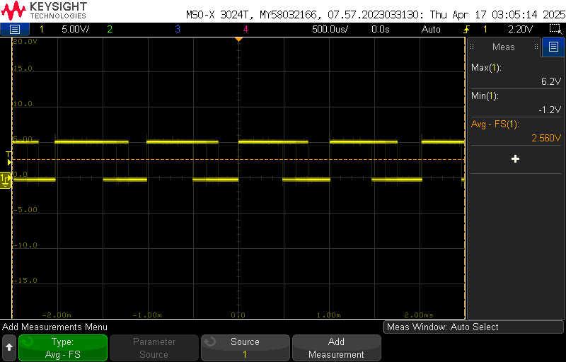

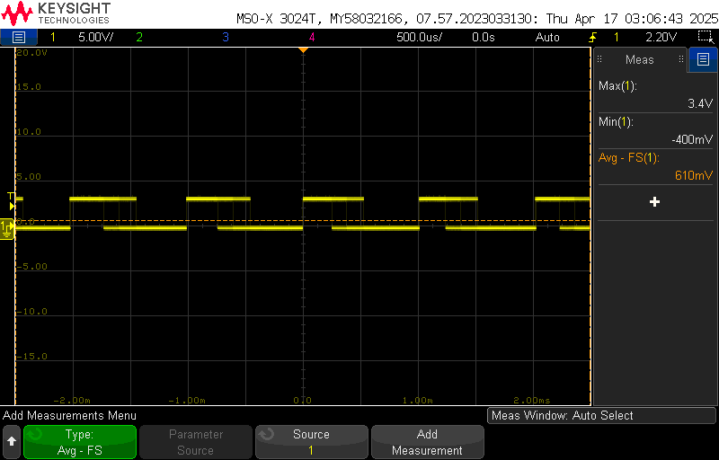

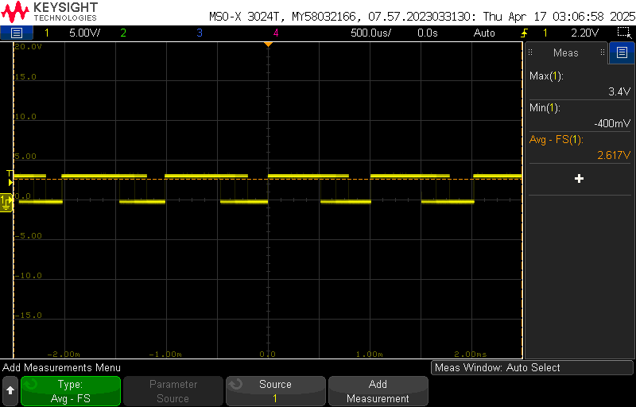







Digital to power shall convert three high and three low PWM signals from 3.3 VDC to 5 VDC.
U
V
W
3.4 V 6.0-6.2 V

Slide 18
MCU shall generate three high and three low 3.3 VDC PWM signals with the knob signal.
U
V
W

Slide 19
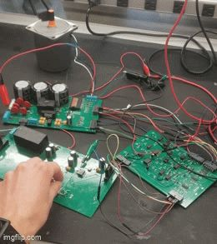
System shall change the motor speed with the knob signal.
Measured Line to Line Waveforms
Speed Knob

Slide 20
Continued
Knob
Positions | Voltage
Low | -.045V
Middle | 1.603V
High | 3.285
PWM
Signal | Frequency (kHz) | Minimum Voltage | Maximum Voltage | Phase Offset (degrees) | Low Pot Value - Low Frequency | High Pot Value - High Frequency
1H | 1 | -0.13 | 3.65V | 0 | TRUE | TRUE
1L | 1 | -0.13 | 3.65V | 0 | TRUE | TRUE
2H | 1 | -0.13 | 3.65V | 120 | TRUE | TRUE
2L | 1 | -0.13 | 3.65V | 120 | TRUE | TRUE
3H | 1 | -0.13 | 3.65V | 240 | TRUE | TRUE
3L | 1 | -0.13 | 3.65V | 240 | TRUE | TRUE

Slide 21
Motor On/Off LED
FSR 5

Slide 22
MCU shall toggle the motor on/off LED signal to 3.3 VDC with the button signal.
~0 V when button off 3.4 V when button on

Slide 23
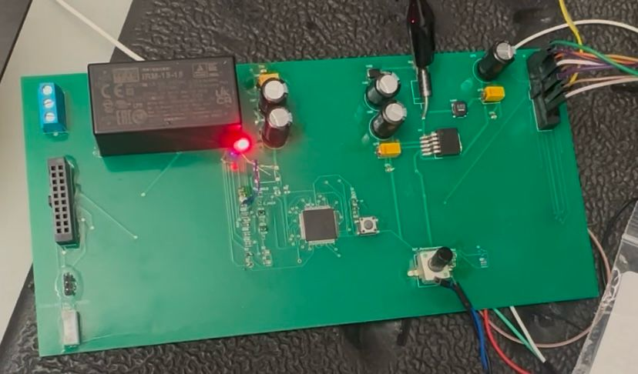
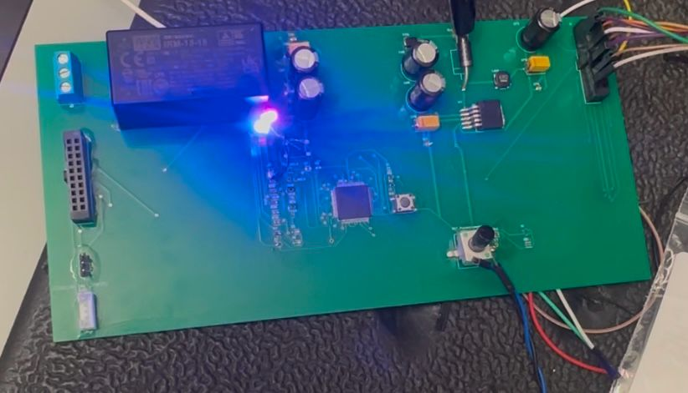
System shall toggle the motor on/off LED between on and off states with the motor on/off signal.
Motor LED (blue) off when on/off button is off Motor LED (blue) on when on/off button is on
(motor is off) (motor is on)

Slide 24
System On/Off LED
FSR 6

Slide 25
MCU shall toggle the circuit on/off LED signal to 3.3 VDC when the board receives power.
3.4V when circuit is on

Slide 26
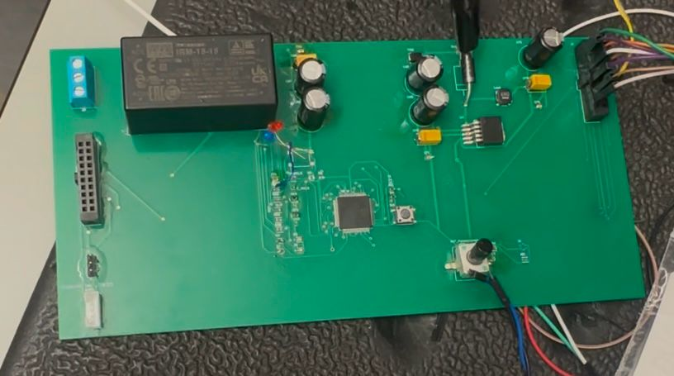
System shall toggle the circuit on/off LED when the board is connected to power with the circuit on/off signal
System LED (red) off when 15 V not applied System LED (red) on when 15 V applied
(system is off) (system is on)

Slide 27
Diagnostic Feedback
FSR 7

Slide 28
Diagnostic feedback circuit shall transport the voltage, current, and temperature signals from across the isolation barrier to the MCU.
 | Input Voltage | Output Voltage
bus.v | 15 V | 3.9 V
ilim.v | 15 V | 3.9 V
ips.temp | 15 V | 3.9 V

Slide 29
Power Control shall generate 60 V_{DC} voltage, current, and temperature feedback signals.
 |  | Output Voltage | Notes
bus.v | voltage
ilim.v | current | 0 | Built for 30 A, 2 A results in zero
ips.temp | temperature

